Slide 1
EVENT MANAGEMENT SYSTEM

Slide 2
agenda
MODULES 1
TECHNOLOGY USED 2
SCREENSHOTS 3
DETAILED EXPLANATION 4
YET TO COMPLETE 5

Slide 3
Modules:
User Authentication
Event Creation
Event Listing
Event Registration
Admin Panel

Slide 4
Technology Used:
React for Front End
Spring Boot for Back End
PostgreSQL for Database
Postman for Rest Client

Slide 5
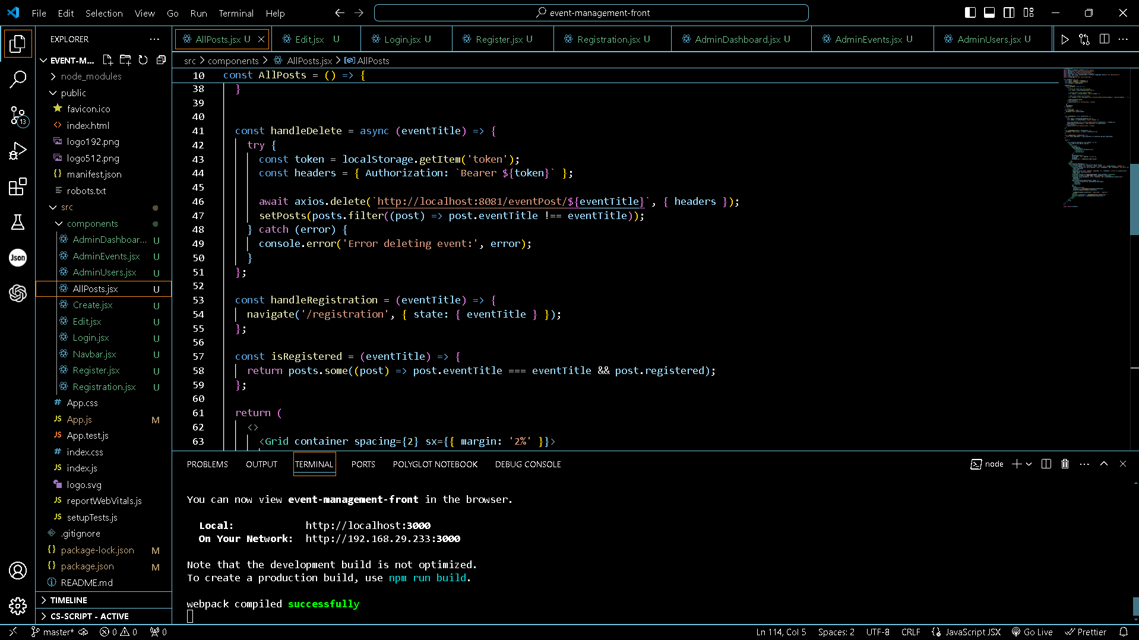
Screenshots: React Console

Slide 6
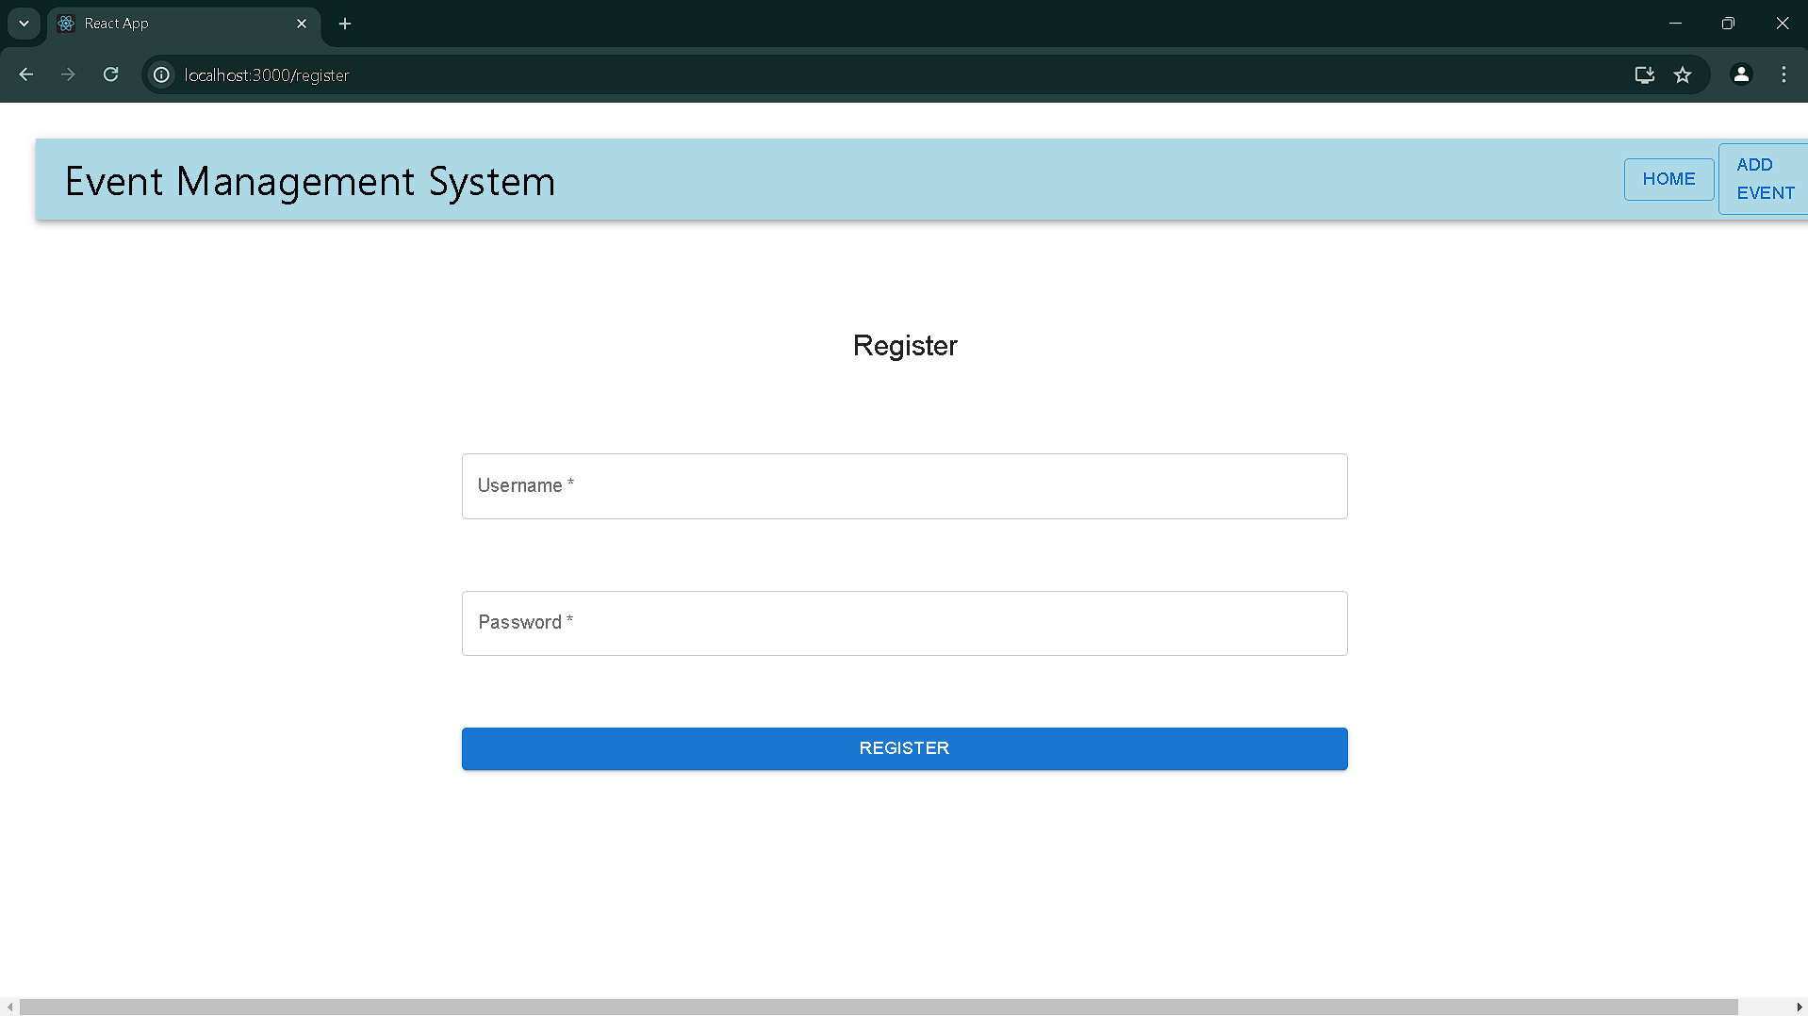
Screenshots: Register Page

Slide 7
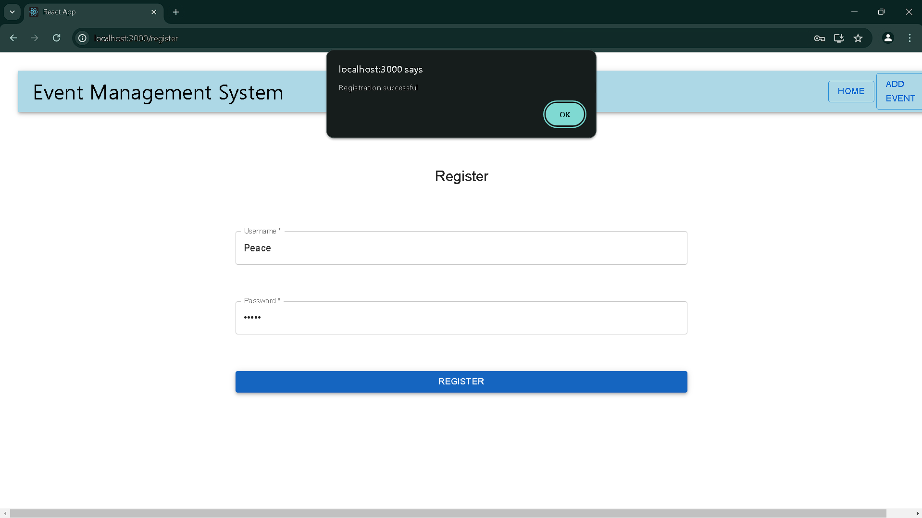
Screenshots: Register Successful

Slide 8
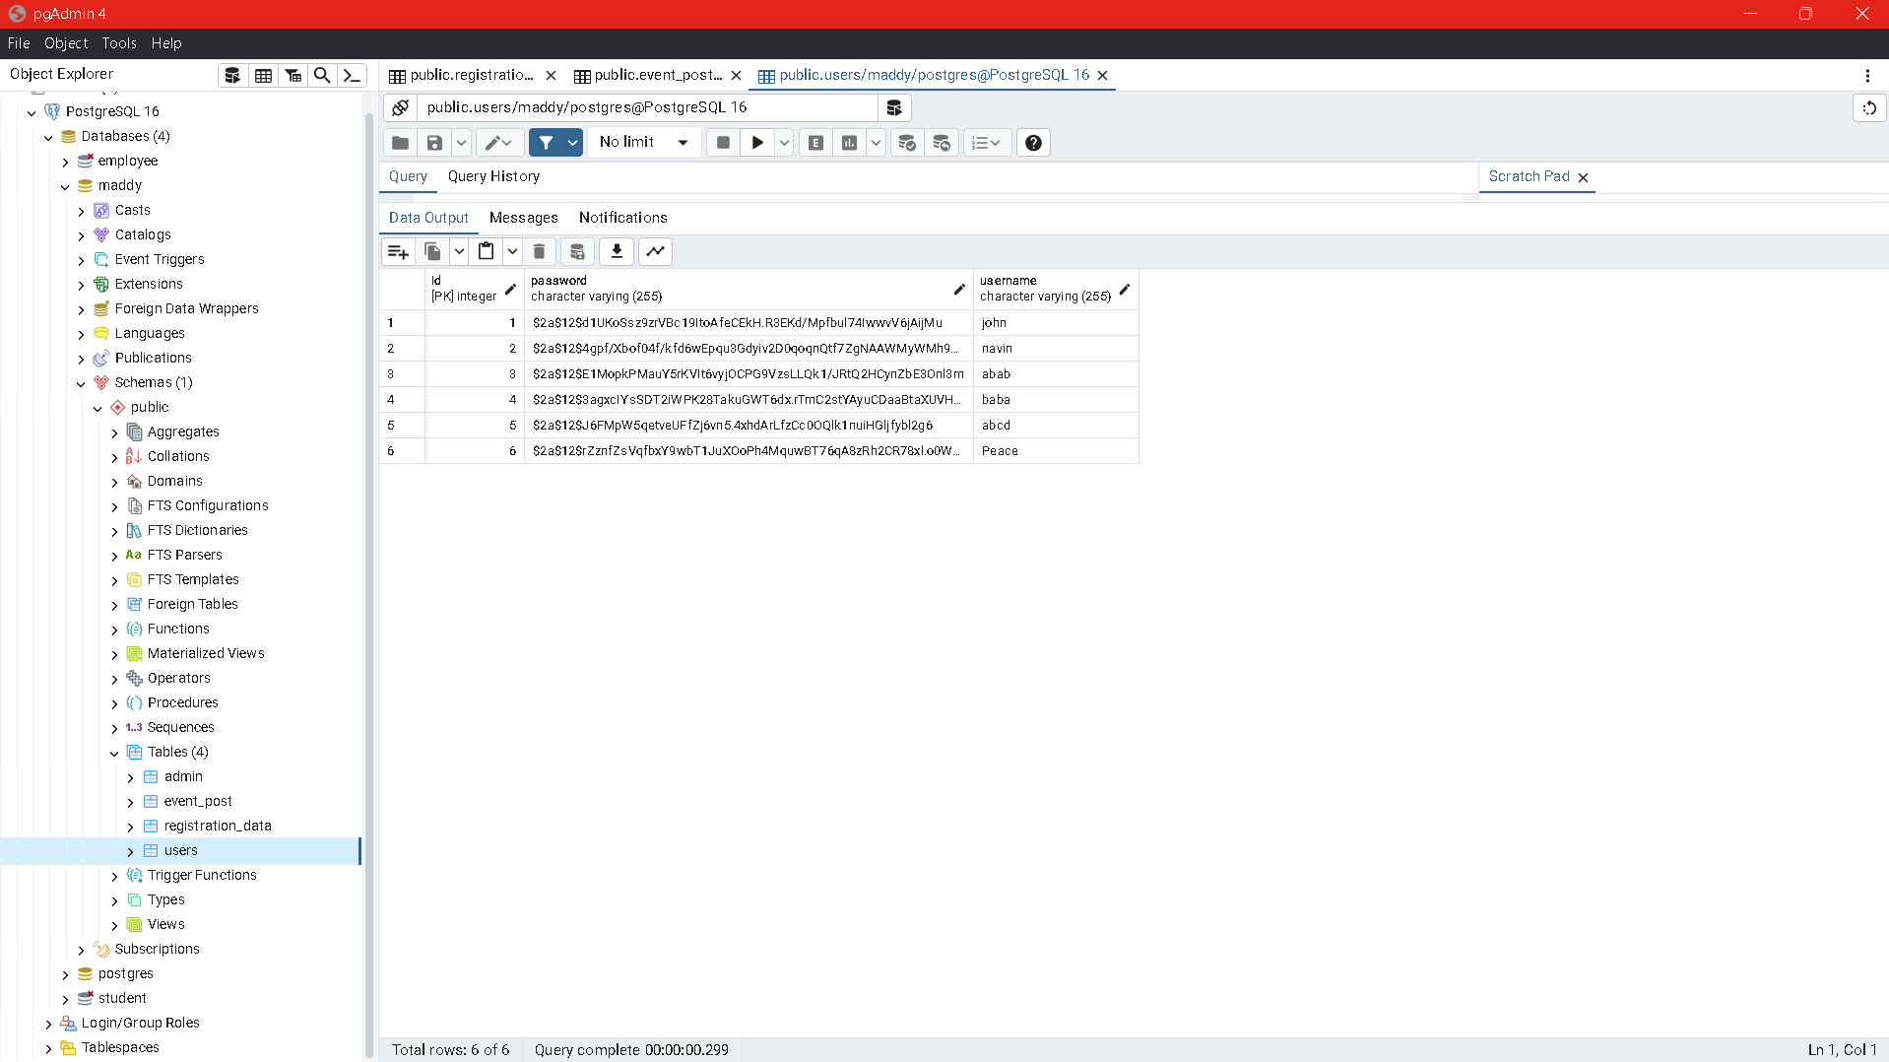
Screenshots: Database Updation

Slide 9
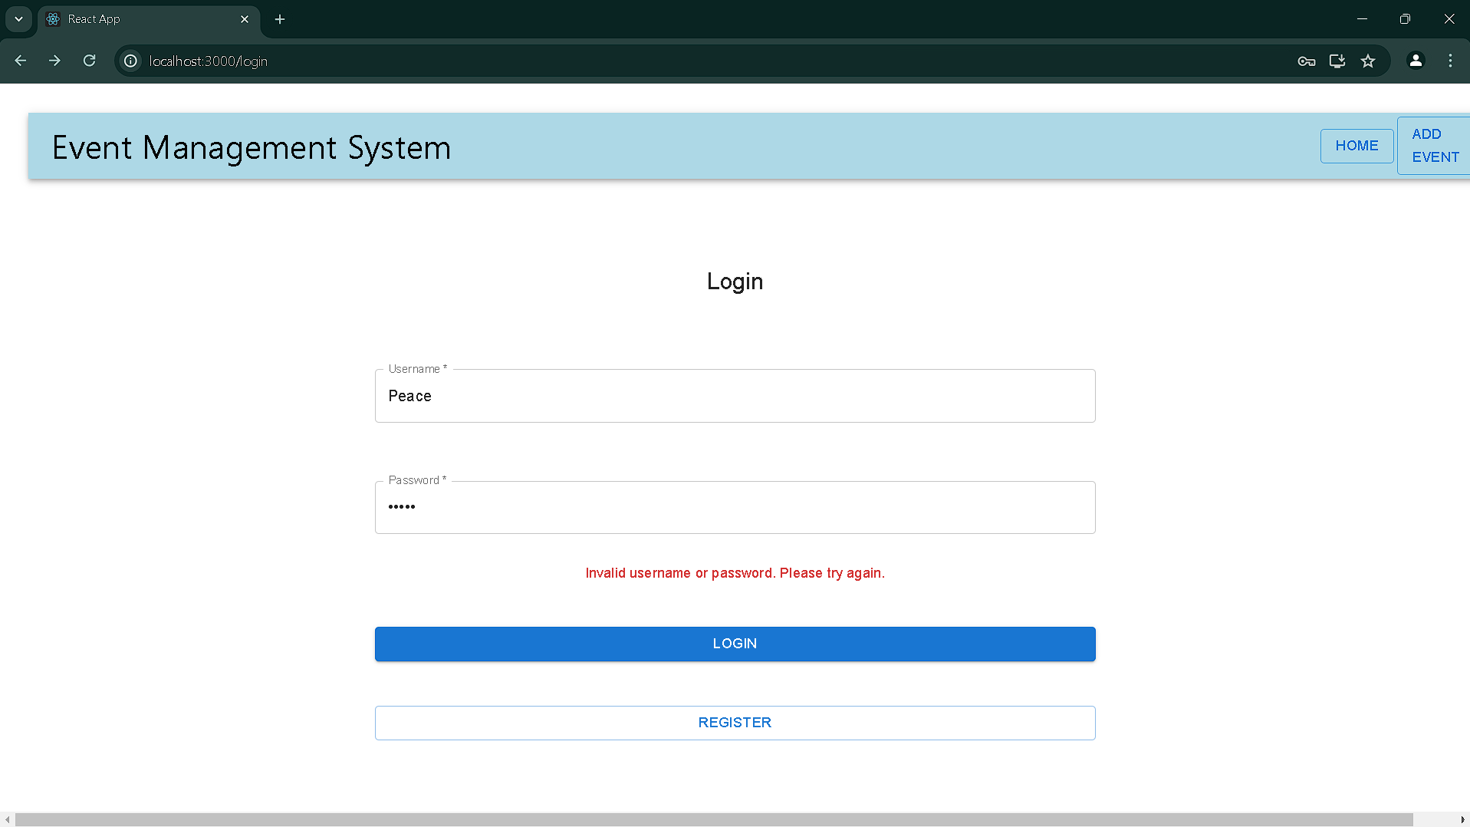
Screenshots: Invalid Credentials Handling

Slide 10
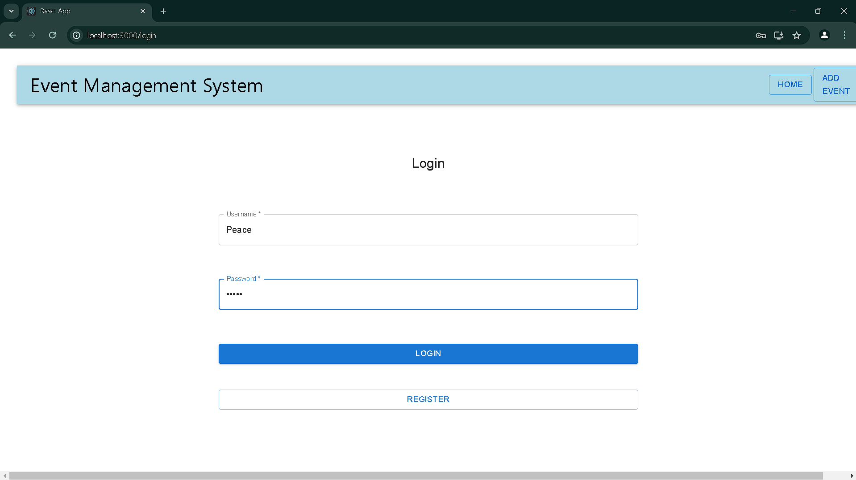
Screenshots: Login Successful

Slide 11
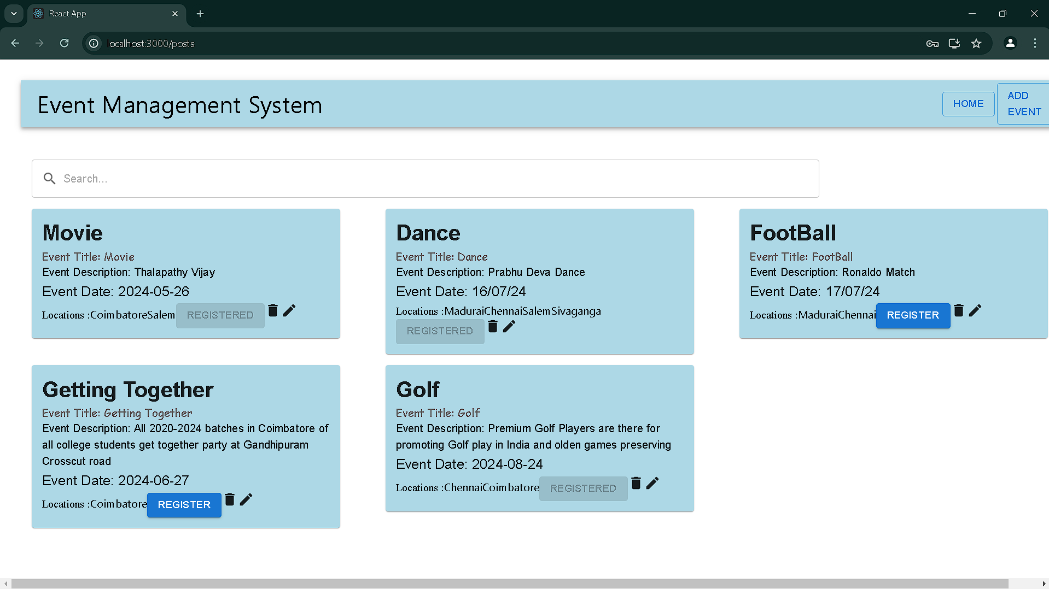
Screenshots: Home Page

Slide 12
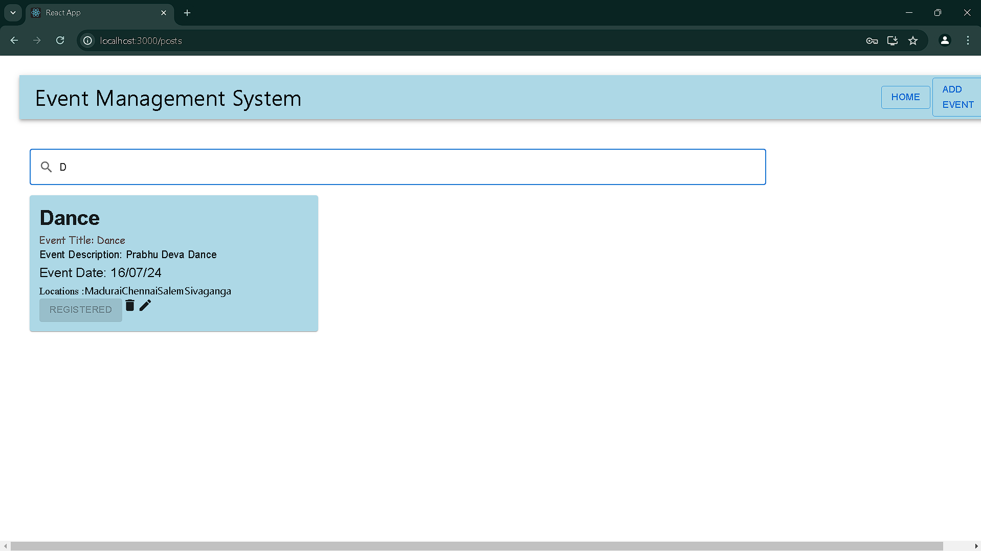
Screenshots: Searching Event

Slide 13
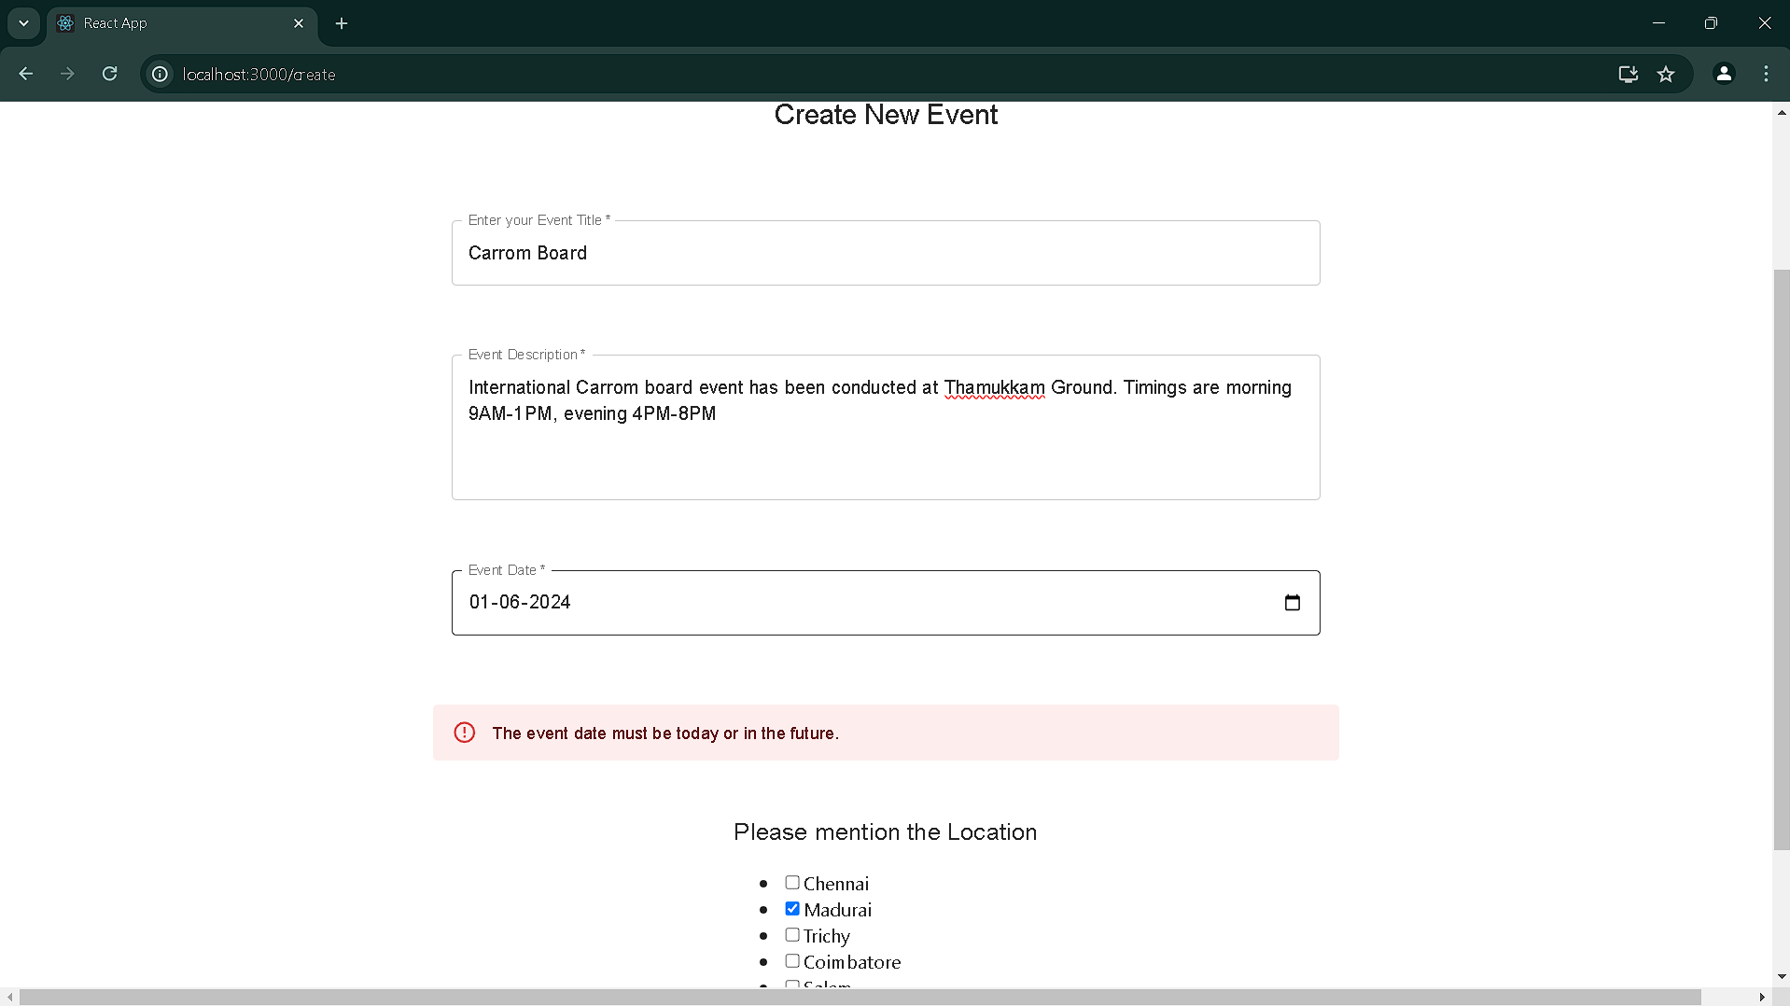
Screenshots: Creating New Event-Date Error

Slide 14
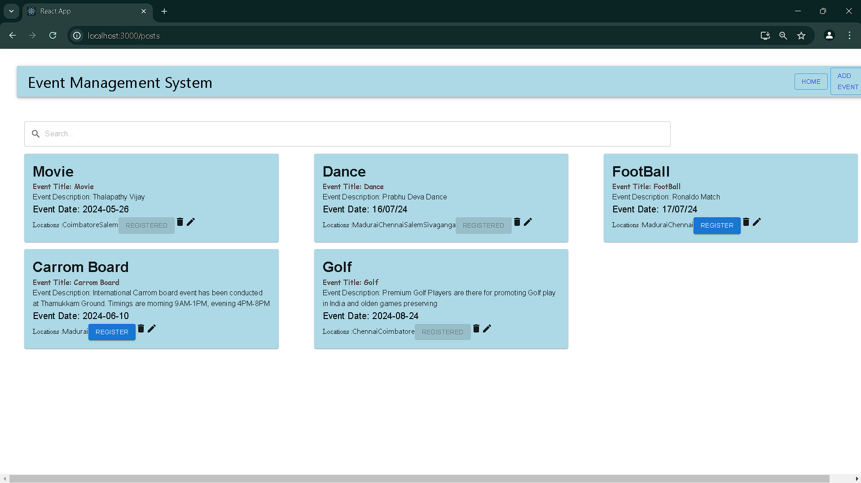
Screenshots: Event Creation Successful

Slide 15
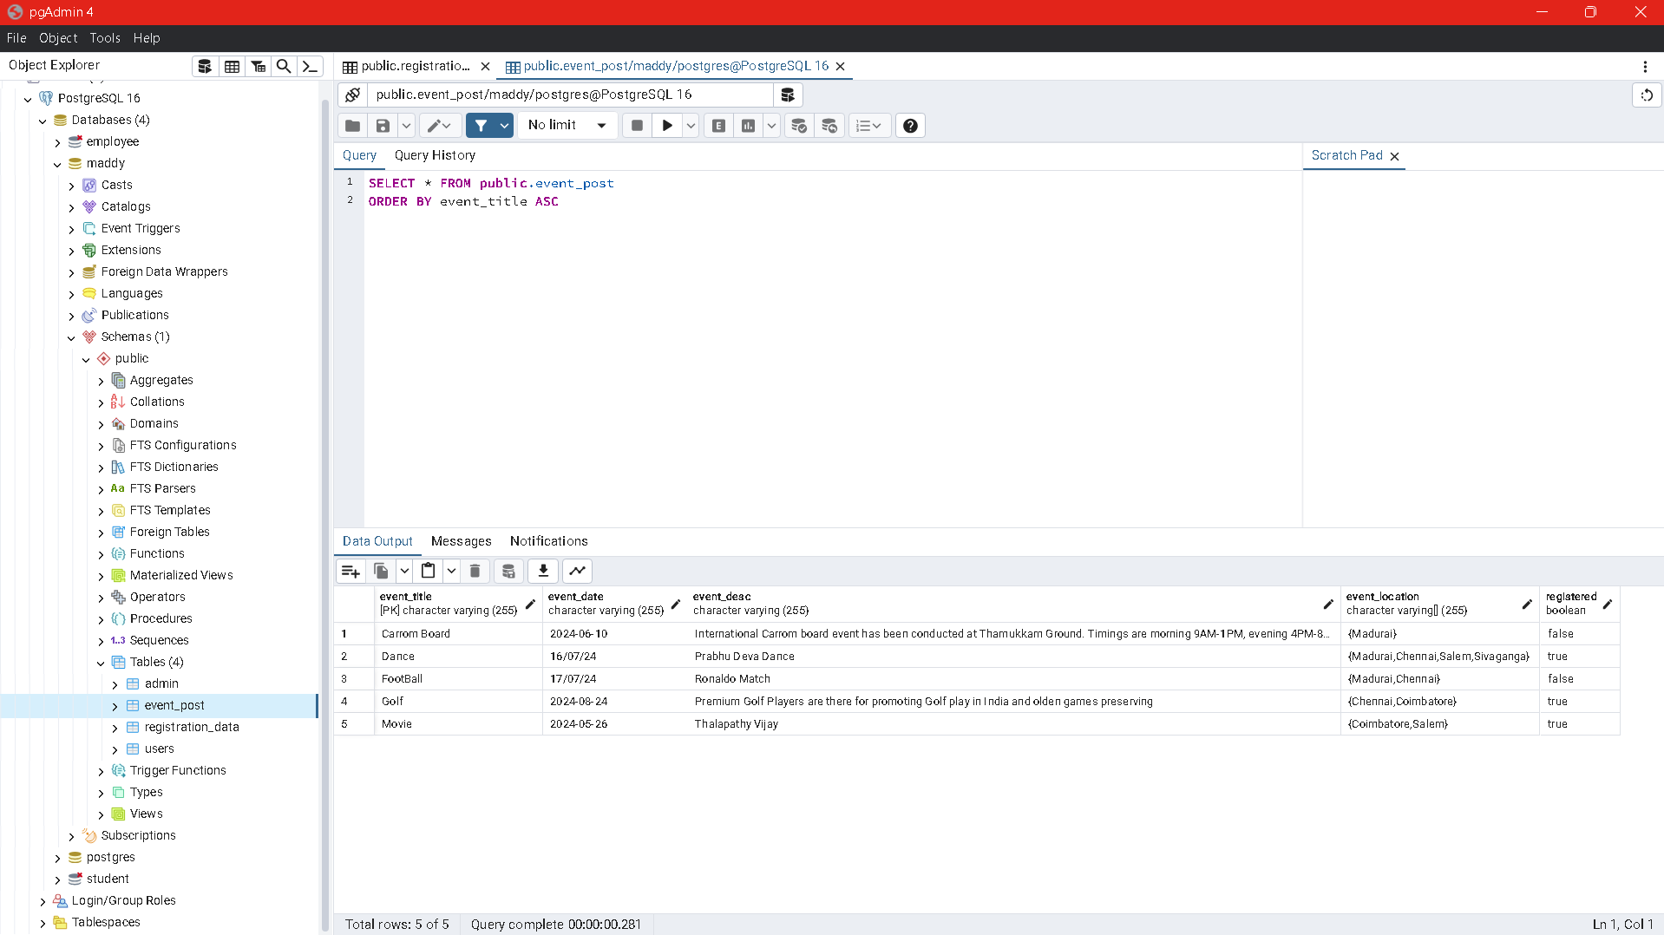
Screenshots: Update in Database

Slide 16
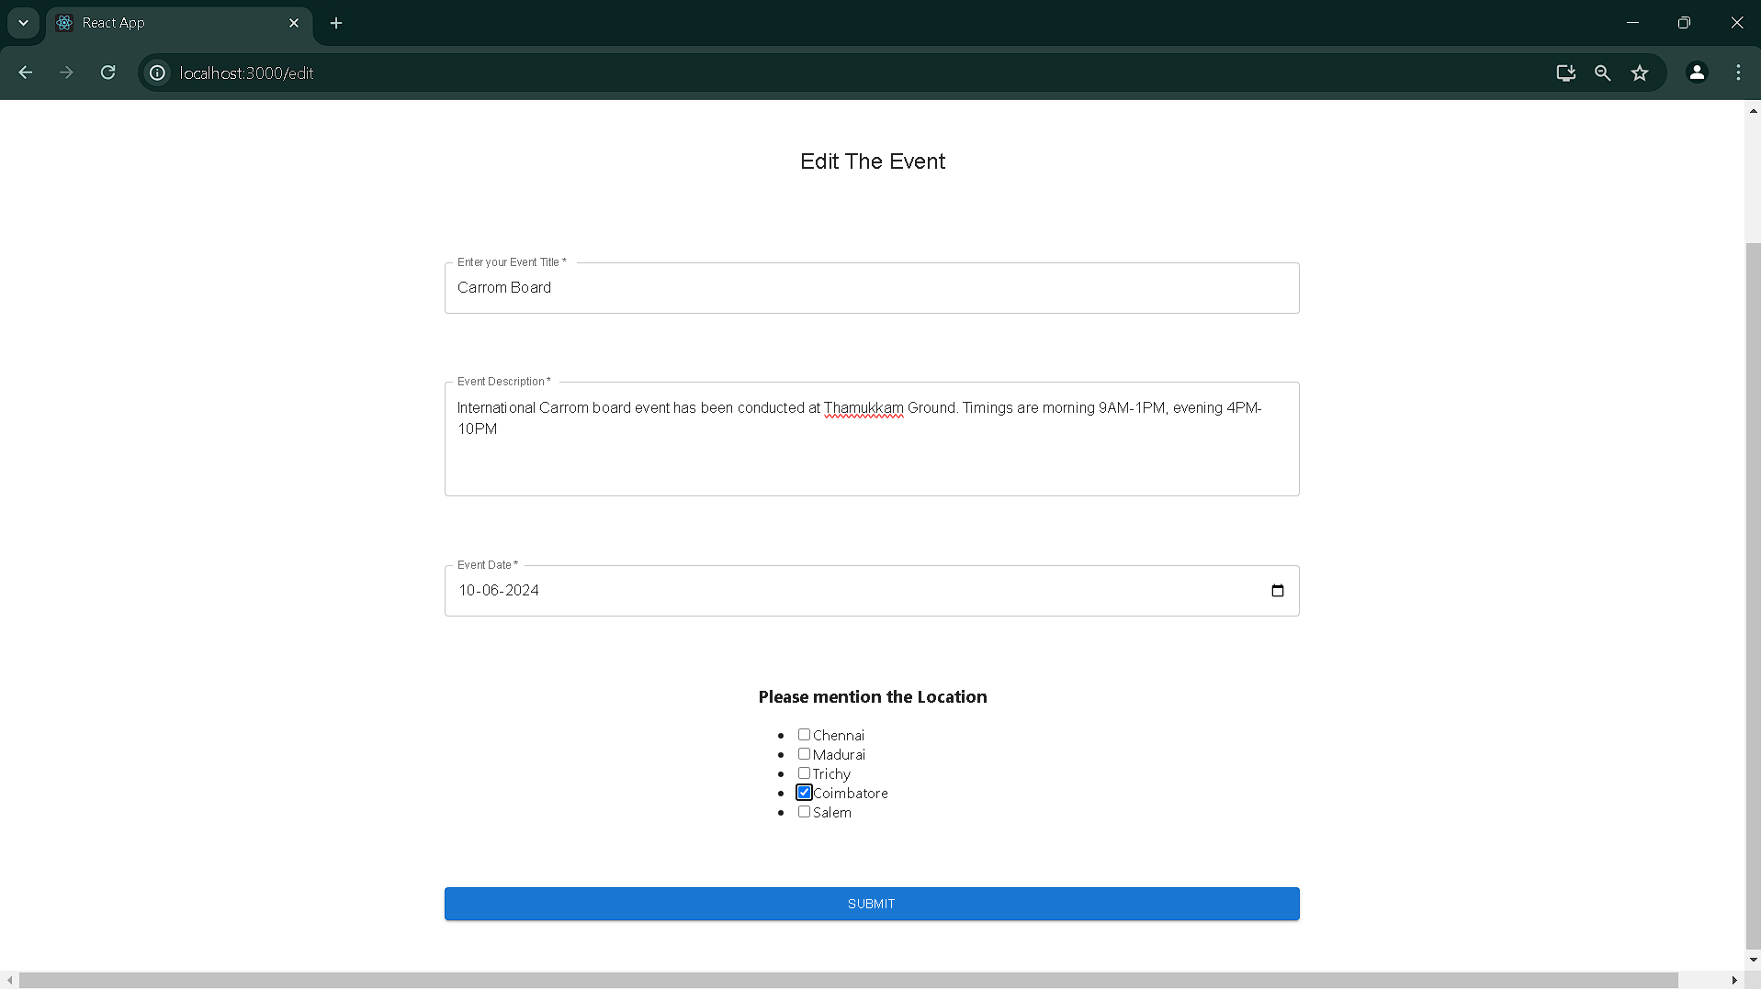
Screenshots: Edit the Event

Slide 17
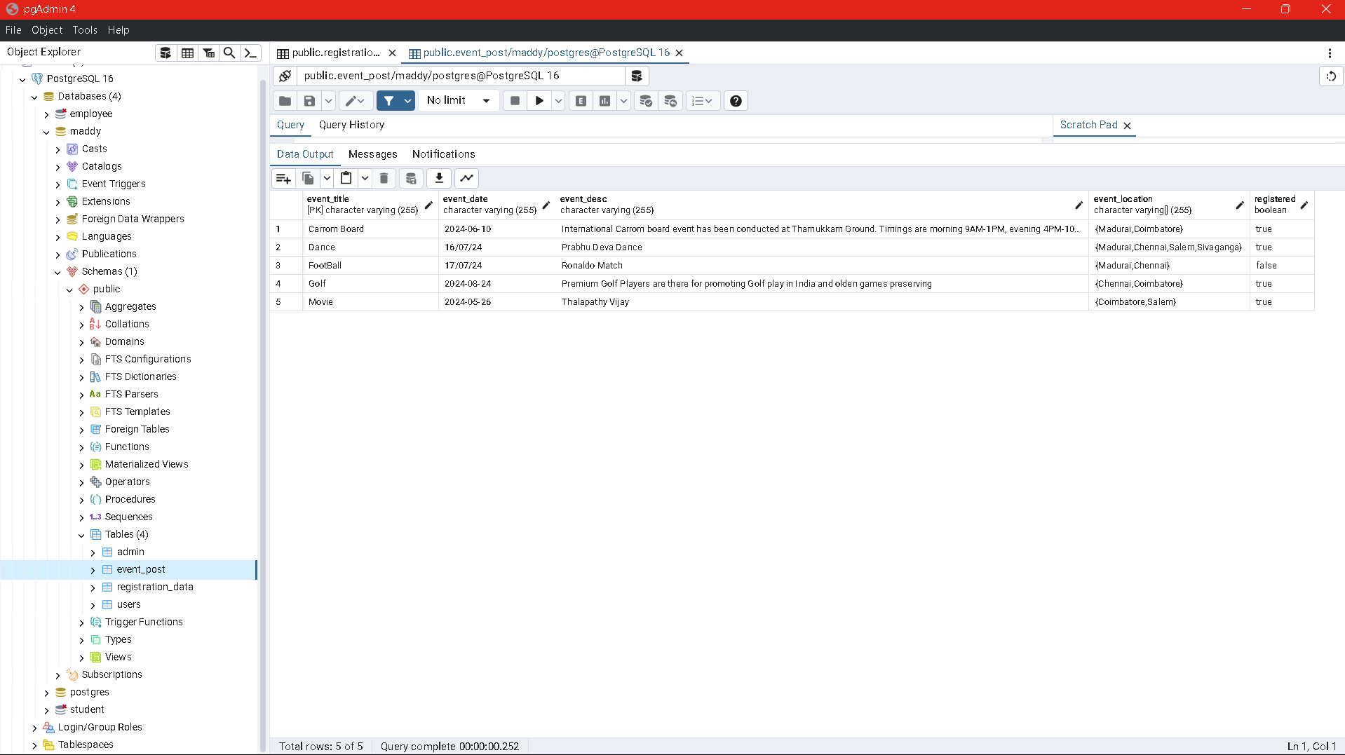
Screenshots: Updated Event in Database

Slide 18
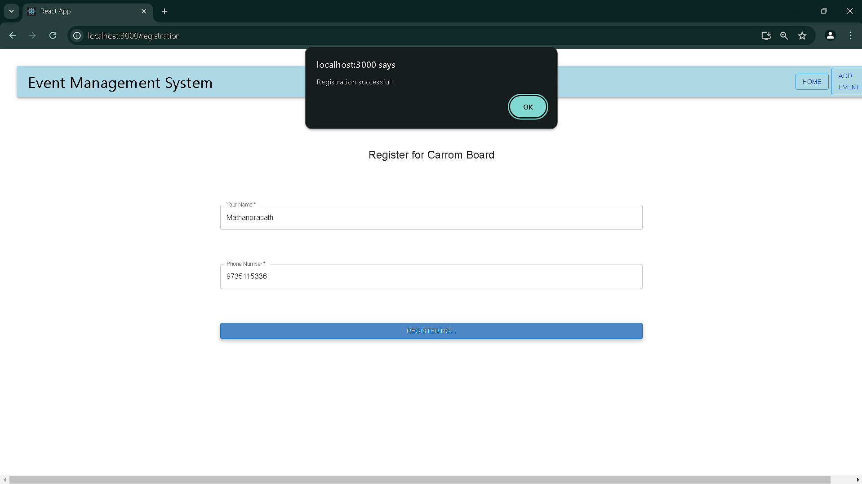
Screenshots: Register For the Event

Slide 19
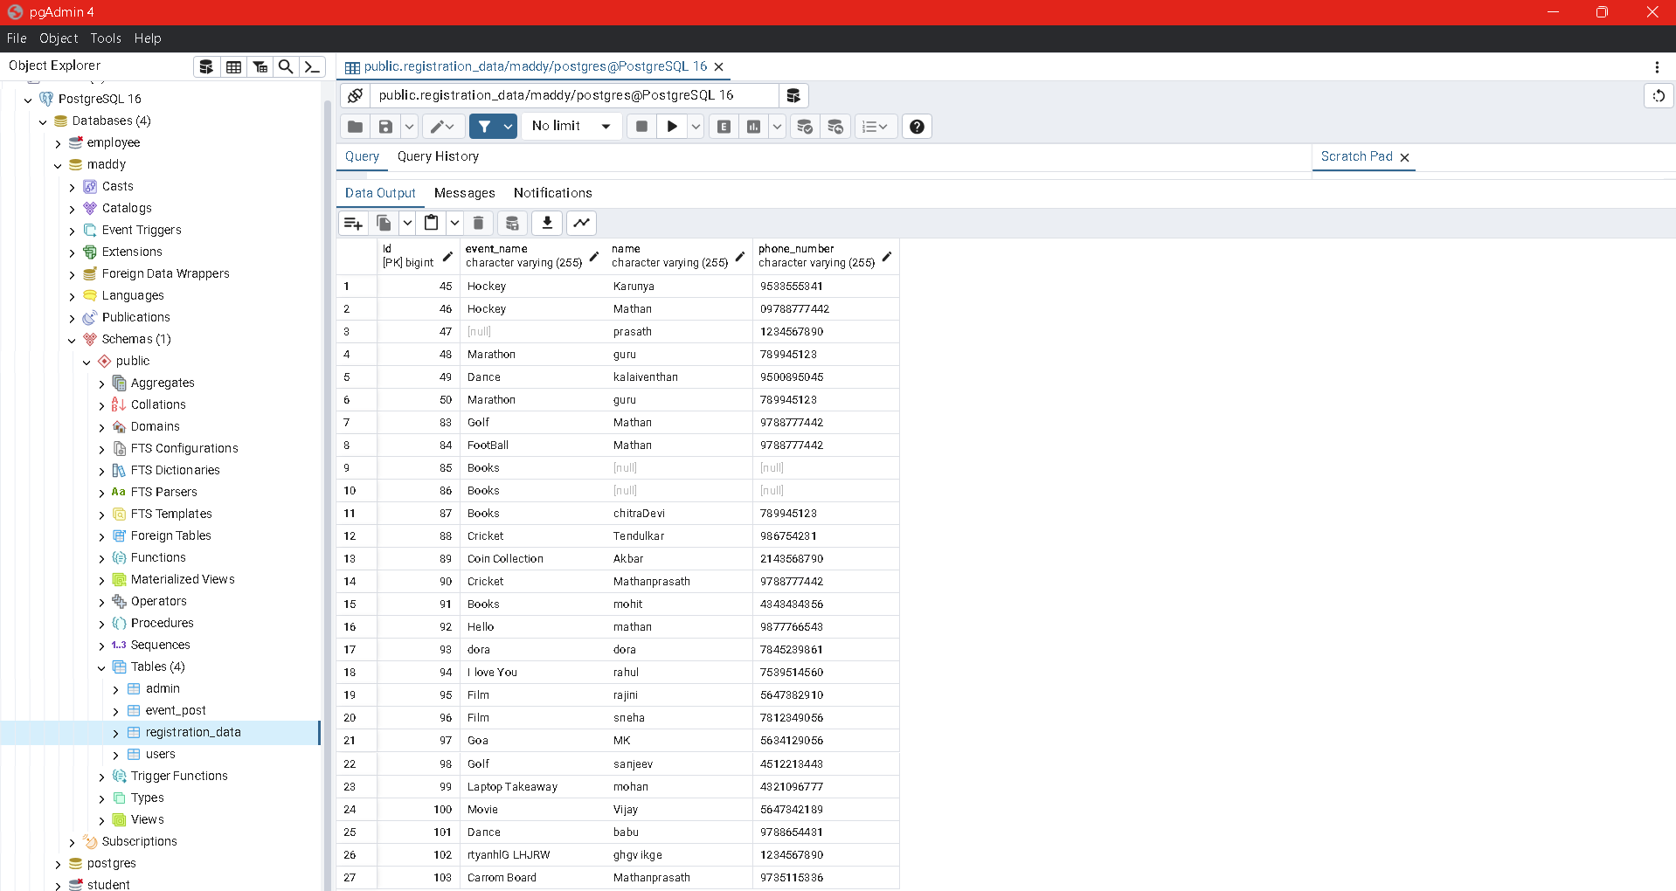
Screenshots: Register Update in Database

Slide 20
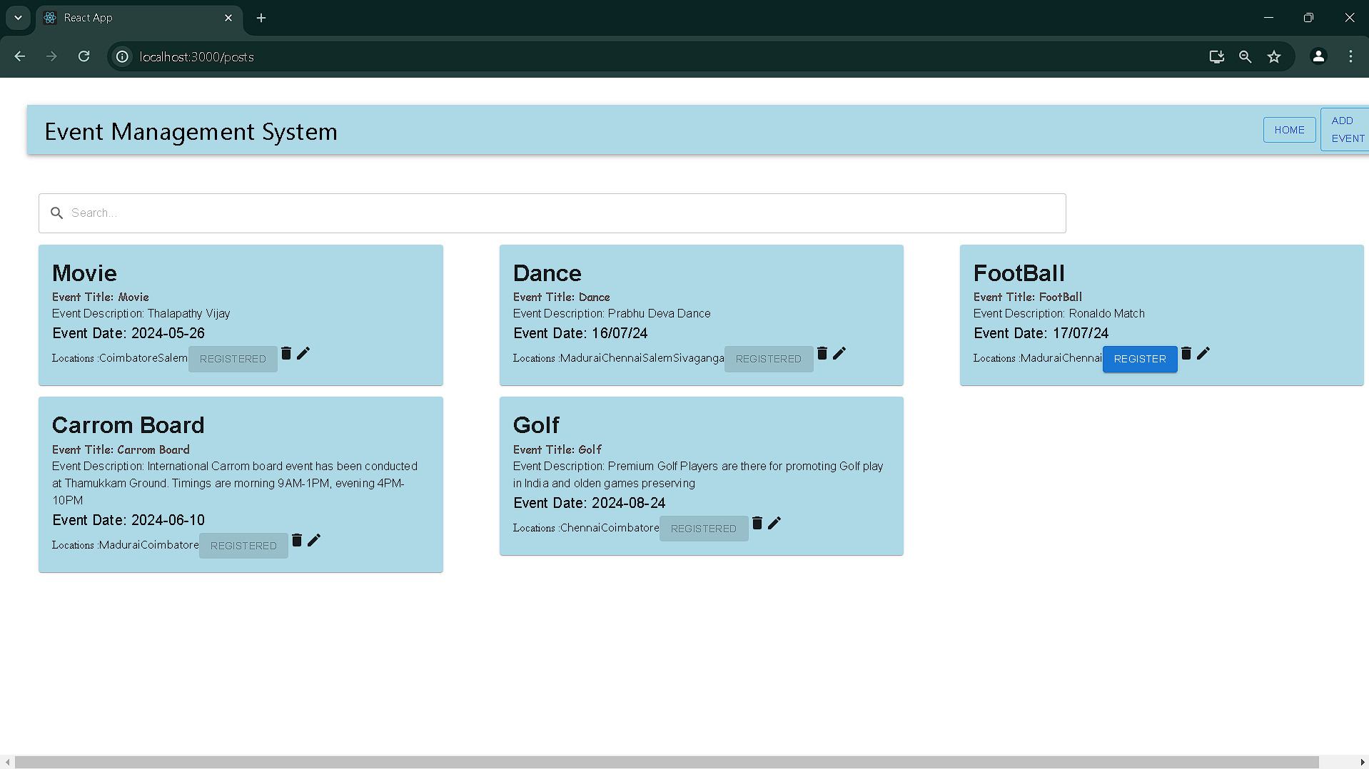
Screenshots: Registered Event

Slide 21
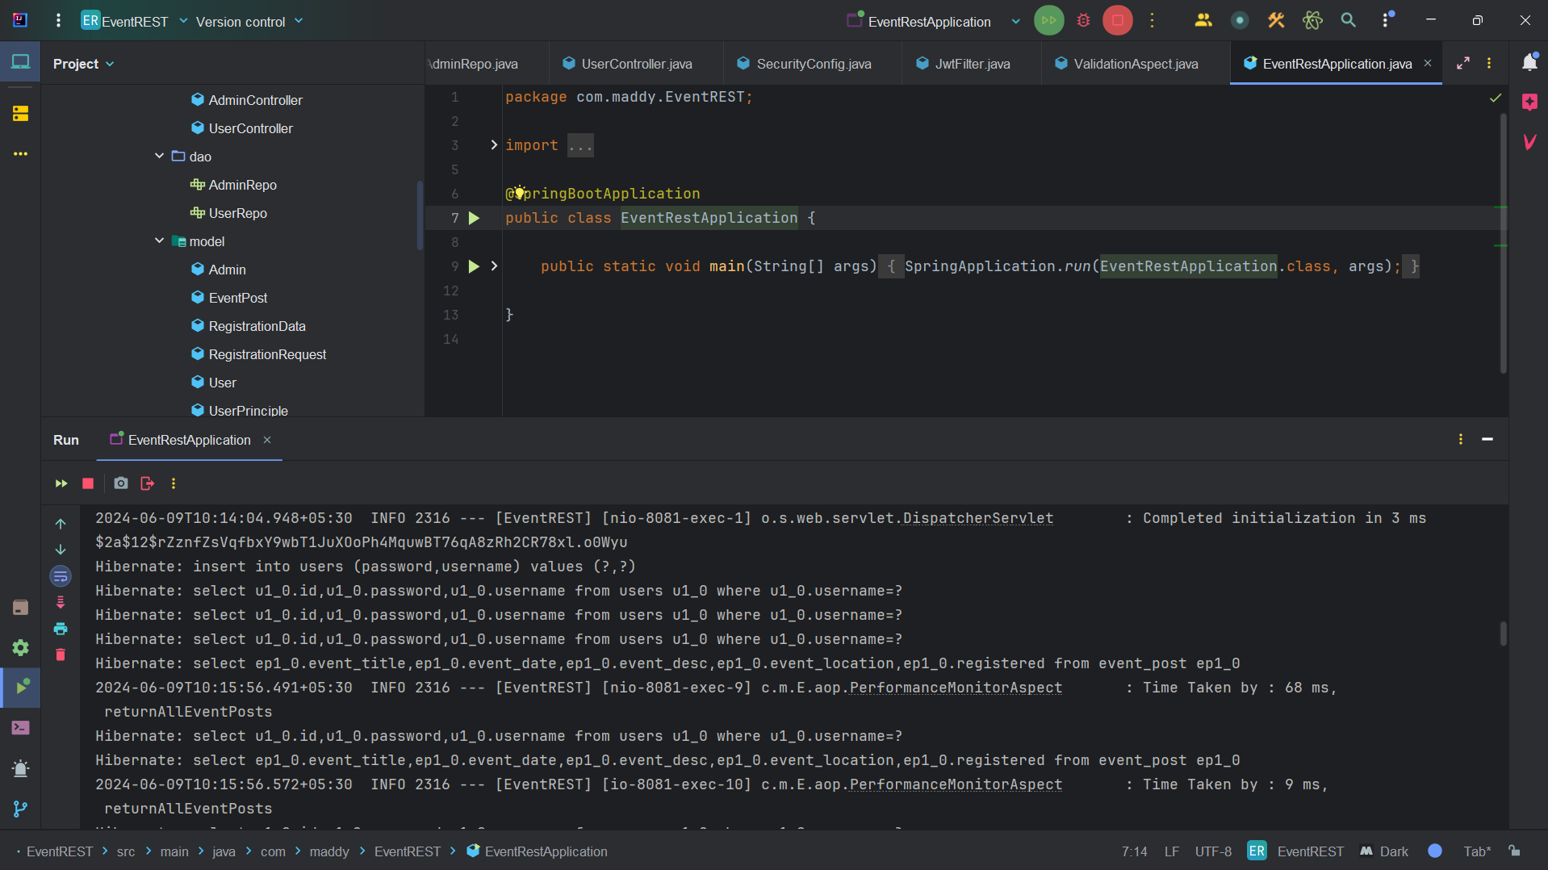
Screenshots: Backend Spring Boot with AOP

Slide 22
Detailed Explanation:

Slide 23
Yet To Complete
Admin Panel

Slide 24
Thank You

